Slide 1

Multi-Level Security
CIS 360 – Prof. C. R. Johnson
University of Wisconsin – Stevens Point

Slide 2
Access Control at Different Abstractions
Using principals
Determines which principals (user accounts) can access what documents
Using subjects
Determines which subjects (processes) can access what resources
This is where BLP focuses on

Slide 3
Multi-Level Security (MLS)
There are security classifications or security levels
Users/principals/subjects have security clearances
Objects have security classifications
Example of security levels
Top Secret
Secret
Confidential
Unclassified
In this case Top Secret > Secret > Confidential > Unclassified
Security goal (confidentiality): ensures that information do not flow to those not cleared for that level
Notes:
Goal is to be able to check computer systems so that they can securely process classified information.

Slide 4
Multi-level Security (MLS)
The capability of a computer system to carry information with different sensitivities (i.e. classified information at different security levels), permit simultaneous access by users with different security clearances and needs-to-know, and prevent users from obtaining access to information for which they lack authorization.
Discretionary access control fails to achieve MLS
Typically use Mandatory Access Control
Primary Security Goal: Confidentiality

Slide 5
Bell-LaPadula Model: A MAC Model for Achieving Multi-level Security
Introduce in 1973
Air Force was concerned with security in time-sharing systems
Many OS bugs
Accidental misuse
Main Objective:
Enable one to formally show that a computer system can securely process classified information

Slide 6
What is a Security Model?
A model describes the system
e.g., a high level specification or an abstract machine description of what the system does
A security policy
defines the security requirements for a given system
Verification techniques that can be used to show that a policy is satisfied by a system
System Model + Security Policy = Security Model
Notes:
Define an abstract model that can be used to describe computer systems.
the model
Define what does it mean for a system in the model to be secure.
the policy
Develop techniques to prove that a system in the model is secure

Slide 7
Approach of BLP
Use state-transition systems to describe computer systems
Define a system as secure iff. every reachable state satisfies 3 properties
simple-security property, *-property, discretionary-security property
Prove a Basic Security Theorem (BST)
so that give the description of a system, one can prove that the system is secure

Slide 8
The BLP Security Model
A computer system is modeled as a state-transition system
There is a set of subjects; some are designated as trusted.
Each state has objects, an access matrix, and the current access information.
There are state transition rules describing how a system can go from one state to another
Each subject s has a maximal sec level L_{m}(s), and a current sec level L_{c}(s)
Each object has a classification level
Notes:
Set of subjects do not change over time.
Access matrix is like in DAC.
Current access information records who wants to access what.

Slide 9
Elements of the BLP Model
Security levels, e.g.: {TS, S, C, U}
L_{m}: Max Sec. Level
L_{c}: Current Sec. Level
L: Class. Level
Subjects
Objects
Current Accesses
Trusted Subjects
Access Matrix

Slide 10
The BLP Security Policy
A state is secure if it satisfies
Simple Security Condition (no read up):
S can read O iff L_{m}(S) ≥ L(O)
The Star Property (no write down): for any S that is not trusted
S can read O iff L_{c}(S) ≥ L(O) (no read up)
S can write O iff L_{c}(S) ≤ L(O) (no write down)
Discretionary-security property
every access is allowed by the access matrix
A system is secure if and only if every reachable state is secure.
Notes:
The simple security condition is natural. Can only read objects of lower level.
The star property is motivated by the Trojan Horse example.
Why it does not apply to trusted subjects? Consider the OS scheduler.
When the maximum level is the same as the current level, then the no-read-up part of the star property is subsumed by the Simple Security Condition. Hence it becomes no write-down only.
Can we say the star property imply the simple security condition in this case?

Slide 11
Implication of the BLP Policy
Objects
Highest
Can Read & Write
Lowest
Can Write
Max Level
Subject
Current Level
Can Read

Slide 12
STAR-PROPERTY
Applies to subjects (principals) not to users
Users are trusted (must be trusted) not to disclose secret information outside of the computer system
Subjects are not trusted because they may have Trojan Horses embedded in the code they execute
Star-property prevents overt leakage of information and does not address the covert channel problem
Notes:
Cannot prevent users read top secret info, then turn and tell someone else.
Where is this protected? In which part is this risk considered and justified?
Humans can be trusted, but not programs they execute.

Slide 13
Is BLP Notion of Security Good?
The objective of BLP security is to ensure
a subject cleared at a low level should never read information classified high
The ss-property and the *-property are sufficient to stop such information flow at any given state.
What about information flow across states?
Notes:
Copying is thought to only being able to occur while reading & writing two objects.
To quote from the report “Prevent simultaneous access to two objects if flow of information between them could be objectionable.”

Slide 14
BLP Security Is Not Sufficient!
Consider a system with s₁,s₂,o₁,o₂
f_{S}(s₁)=f_{C}(s₁)=f_{O}(o₁)=high
f_{S}(s₂)=f_{C}(s₂)=f_{O}(o₂) =low
And the following execution
s₁ gets access to o₁, read something, release access, then change current level to low, get write access to o₂, write to o₂
Every state is secure, yet illegal information exists
Solution: tranquility principle: subject cannot change current levels, or cannot drop to below the highest level read so far
Notes:
Another solution is to mandate the update of current security levels. Reading an object raises its current level to its own level.

Slide 15
More on the BLP Notion of Security
When a subject A copies information from high to a low object f, this violates the star-property, but no information leakage occurred yet
Only when B, who is not cleared at high, reads f, does leakage occurs
If the access matrix limits access to f only to A, then such leakage may never occur
BLP notion of security is neither sufficient nor necessary to stop illegal information flow (through direct/overt channels)
The state based approach is too low level and limited in expressive power

Slide 16
How to Fix The BLP Notion of Security?
May need to differentiate externally visible objects from other objects
e.g., a printer is different from a memory object
State-sequence based property
e.g., exists no sequence of states so that there is an information path from a high object to a low externally visible object or to a low subject

Slide 17
The Basic Security Theorem
This provides the verification techniques piece in
Model – Policy – Verification framework
Restatement of The Basic Security Theorem: A system is a secure system if and only if the starting state is a secure state and each action (concrete state transition that could occur in an execution sequence) of the system leads the system into a secure state.

Slide 18
Observations of the BST
The BST is purely a result of defining security as a state-based property.
It holds for any other state-based property
The BST cannot be used to justify that the BLP notion of security is “good”
This is McLean’s main point in his papers
“A Comment on the Basic Security Theorem of Bell and LaPadula” [1985]
“Reasoning About Security Models” [1987]
“The Specification and Modeling of Computer Security” [1990]
Notes:
John McLean criticizes the BLP in the 1980’s, and Bell responded.

Slide 19
Main Contributions of BLP
The overall methodology to show that a system is secure
adopted in many later works
The state-transition model
which includes an access matrix, subject security levels, object levels, etc.
The introduction of *-property
ss-property is not enough to stop illegal information flow

Slide 20
Other Limitations with BLP
Deal only with confidentiality, does not deal with integrity at all
Confidentiality is often not as important as integrity in most situations
Addressed by integrity models (such as Biba, Clark-Wilson, which we will cover later)
Does not deal with information flow through covert channels
Notes:
A low-level subject can write to arbitrary high level objects.
Even for confidentiality, its protection is limited.

Slide 21
Overt (Explicit) Channels vs. Covert Channels
Security objective of MLS in general, BLP in particular
high-classified information cannot flow to low-cleared users
Overt channels of information flow
read/write an object
Covert channels of information flow
communication channel based on the use of system resources not normally intended for communication between the subjects (processes) in the system
Notes:
Covert communication channels (also called subliminal channels) are often motivated as being solutions to the ``prisoners' problem.'' Consider two prisoners in separate cells who want to exchange messages, but must do so through the warden, who demands full view of the messages (that is, no encryption). A covert channel enables the prisoners to exchange secret information through messages that appear to be innocuous. A covert channel requires prior agreement on the part of the prisoners. For example if an odd length word corresponds to ``1'' and an even length word corresponds to ``0'', then the previous sentence contains the subliminal message ``101011010011''.

Slide 22
Examples of Covert Channels
Using file lock as a shared boolean variable
By varying its ratio of computing to input/output or its paging rate, the service can transmit information to a concurrently running process
Timing of packets being sent
Covert channels are often noisy
However, information theory and coding theory can be used to encode and decode information through noisy channels
Notes:
Cover channels occur with shared resources.

Slide 23
More on Covert Channels
Covert channels cannot be blocked by *-property
It is generally very difficult, if not impossible, to block all covert channels
One can try to limit the bandwidth of covert channels
Military requires cryptographic components be implemented in hardware
to avoid trojan horse leaking keys through covert channels

Slide 24
More on MLS: Security Levels
Used as attributes of both subjects & objects
clearance & classification
Typical military security levels:
top secret ≥ secret ≥ confidential ≥ unclassified
Typical commercial security levels
restricted ≥ proprietary ≥ sensitive ≥ public
Notes:
A single level is not good enough. Someone having top secret, say, in the army, will be able to read all

Slide 25
Security Categories
Also known as compartments
Typical military security categories
army, navy, air force
nato, nasa, noforn
Typical commercial security categories
Sales, R&D, HR
Dept A, Dept B, Dept C

Slide 26
Security Labels
Labels = Levels × P (Categories)
Define an ordering relationship among Labels
(e1, C1) ≤ (e2, C2) iff. e1 ≤e2 and C1 ⊆ C2
This ordering relation is a partial order
reflexive, transitive, anti-symmetric
e.g., ⊆
All security labels form a lattice

Slide 27
The need-to-know principle
Even if someone has all the necessary official approvals (such as a security clearance) to access certain information they should not be given access to such information unless they have a need to know: that is, unless access to the specific information necessary for the conduct of one's official duties.
Can be implemented using categories and or DAC
Notes:
The Discretionary Security Requirement addresses need-to-know.
Related with the principle of least privilege.

Slide 28
Multi-level security models
A mechanism for monitoring access control in a system where both principals and objects have security labels drawn from a hierarchy of labels
Multi-level security models are best-known examples
Bell-LaPadula Model basis for many, or most, of these
Problems involved both design and implementation led to development of formal security models
Bell-LaPadula (BLP) model very influential

Slide 29
Bell-LaPadula (BLP) Model
Security levels arranged in linear ordering
Top Secret: highest
Secret
Confidential
Unclassified: lowest
Levels consist of security clearance L(s)
Objects have security classification L(o)

Slide 30
Example
Tamara can read all files
Claire cannot read Personnel or E-Mail Files
James can only read Telephone Lists
Security level | Subject | Object
Top Secret | Tamara | Personnel Files
Secret | Samuel | E-Mail Files
Confidential | Claire | Activity Logs
Unclassified | James | Telephone Lists

Slide 31
Compartments
Documents classified according to compartment(s): categories of information (in fact, aka category)
cryptography
nuclear
biological
reconnaissance
Need to Know Principle: access should be granted only when necessary to perform assigned duties (instance of Least Privilege)
{crypto, nuclear}: must need to know about both to access
{}: no particular compartments

Slide 32
Labels
Label: pair of sensitivity level and set of compartments, e.g.,
(Top Secret, {crypto, nuclear})
(Unclassified, {})
Users are labeled according to their clearance
Document is labeled aka classified
Perhaps each paragraph labeled
Label of document is most restrictive label for any paragraph
Notation: let L(X) be the label of entity X

Slide 33
Restrictiveness of labels
Notation: L1 ⊑ L2
means L1 is no more restrictive than L2
less precisely: L1 is less restrictive than L2
Definition:
Let L1 = (S1, C1) and L2 = (S2, C2)
L1 ⊑ L2 if S1 ≤ S2 and C1 ⊆ C2
Where ≤ is order on sensitivity: Unclassified ≤ Confidential ≤ Secret ≤ Top Secret
e.g.
(Unclassified,{}) ⊑ (Top Secret, {})
(Top Secret, {crypto}) ⊑ (Top Secret, {crypto,nuclear})

Slide 34
Expanding Classifications
Expand the model to add categories to each security classification
Objects placed in multiple categories
Based on “need to know” principle
Example categories: NUC, EUR, US
One can have access to any of these: none, {NUC}, {EUR}, {US}, {NUC, EUR}, … {NUC, EUR, US}
Categories form a lattice under the “subset of” operation

Slide 35
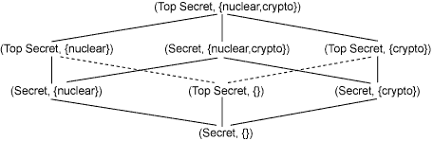
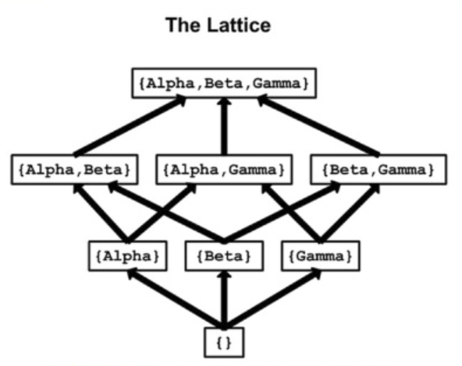
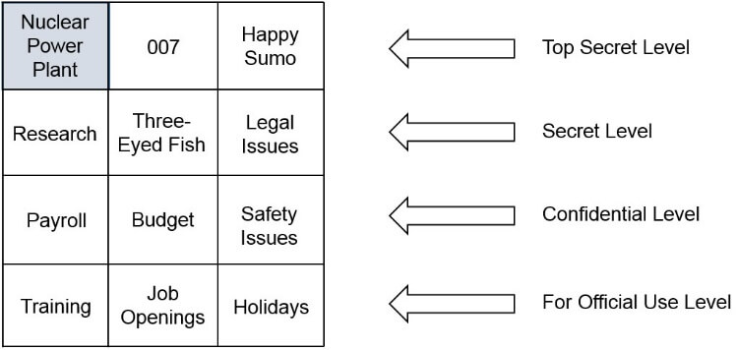
Lattice-Based Controls
Lattice-based access control allows security controls for complex environments.
This lattice, which allows reaching higher and lower data classification, depends on the need of the subject, the label of the object, and the role the subject has been assigned.
Subjects have a least upper bound (LUB) and greatest lower bound (GLB) of access to the objects based on their lattice position.

Slide 36
Label partial order
Conf, {nuc,crypto}
Conf, {nuc}
Conf, {crypto}
Conf, {}

Slide 37
Label partial order
Secret, {nuc, crypto}
Secret, {nuc}
Secret, {crypto}
Secret, {}
Conf, {}

Slide 38
Label partial order
Secret, {nuc, crypto}
Secret, {nuc}
Conf, {nuc,crypto}
Secret, {crypto}
Conf, {nuc}
Secret, {}
Conf, {crypto}
Conf, {}
Notes:
Hasse diagram

Slide 39
Label partial order
Sec, {nuc,crypto}
Secret, {nuc}
Conf, {nuc,crypto}
Secret, {crypto}
Conf, {nuc}
Secret, {}
Conf, {crypto}
Incomparable
Conf, {}

Slide 40
Label partial order
Sec, {nuc,crypto}
Incomparable
Secret, {nuc}
Conf, {nuc,crypto}
Secret, {crypto}
Conf, {nuc}
Secret, {}
Conf, {crypto}
Conf, {}

Slide 41
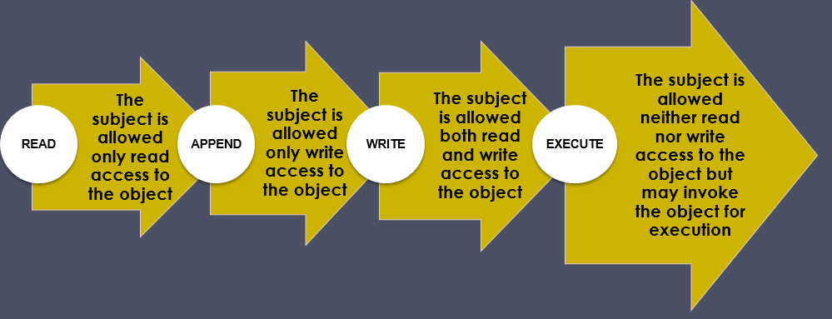
Access Privileges

Slide 42
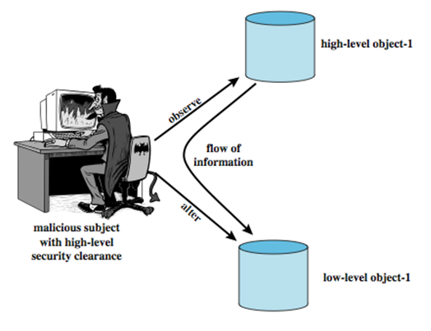
Multilevel Security
Multiple levels of security and data
Subject at a high level may not convey info to a subject at a non-comparable level:
No read up (ss-property): a subj can only read an obj of less or equal sec level
No write down (*-property): a subj can only write into an obj of greater or equal sec level

Slide 43
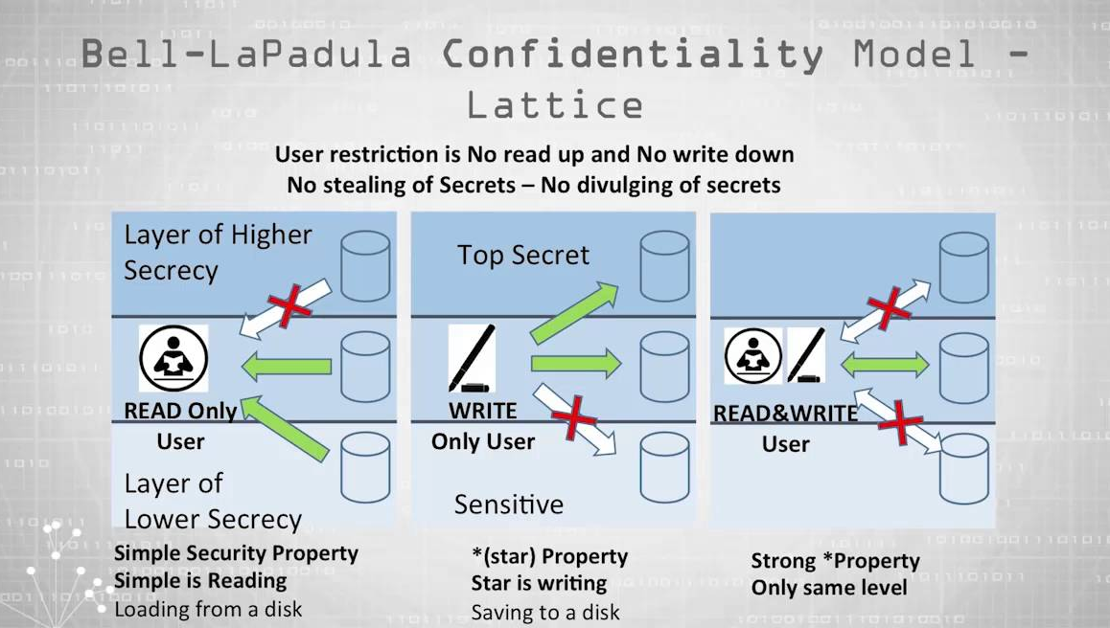
Bell-Lapadula – Read down, Write up
The object labels used by many world governments are confidential, secret, and top-secret. This security model is known as Bell-Lapadulla:
“Top Secret” shall be applied to information, of which the unauthorized disclosure could reasonably be expected to cause exceptionally grave damage to national security.
“Secret” shall be applied to information, of which the unauthorized disclosure could reasonably be expected to cause serious damage to national security.
“Confidential” shall be applied to information, of which the unauthorized disclosure could reasonably be expected to cause damage to national security.1
Private sector companies use labels such as “Internal Use Only” and “Company Proprietary” to categorize information.

Slide 44
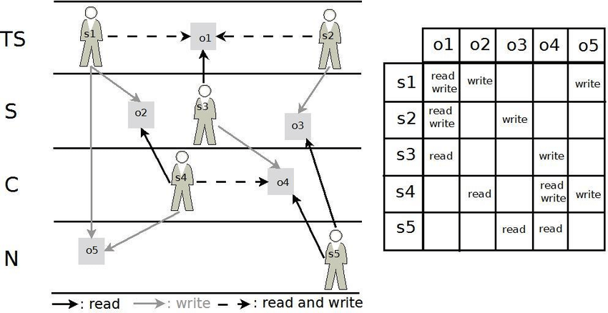
BIBA Model – read up, write down
The inverse of Bell-LaPadula used in corporate structures because where as BLP is for keeping confidentiality, Biba is for maintaining consistency (integrity) in information from the top down.
Biba allows compartmentalization based on reporting structures. Supervisors can read/write with peers. Write to subordinates, who can read that information.

Slide 45
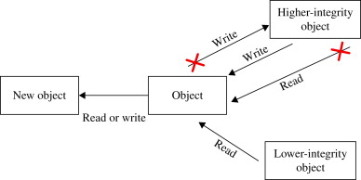

Slide 46
Access control with MLS
When may a subject read an object?
Threat: subject attempts to read information for which it is not cleared
e.g., subject with clearance Unclassified attempts to read Top Secret information
When may a subject write an object?
Threat: subject attempts to launder information by writing into a lower-security object
e.g., subject with clearance Top Secret reads Top Secret information then writes it into an Unclassified file

Slide 47
Access control with MLS
When may a subject read an object?
S may read O if L(O) ⊑ L(S)
object's classification must be below (or equal to) subject's clearance
"no read up"
When may a subject write an object?
S may write O if L(S) ⊑ L(O)
object's classification must be above (or equal to) subject's clearance
"no write down"

Slide 48
Reading with MLS
Scenario:
Colonel with clearance (Secret, {nuclear, Europe})
DocA with classification (Confidential, {nuclear})
DocB with classification (Secret, {Europe, US})
DocC with classification (Top Secret, {nuclear, Europe})
Which documents may Colonel read?

Slide 49
Writing with MLS
Scenario:
Colonel with clearance (Secret, {nuclear, Europe})
DocA with classification (Confidential, {nuclear})
DocB with classification (Secret, {Europe, US})
DocC with classification (Top Secret, {nuclear, Europe})
Which documents may Colonel write?

Slide 50
Data Laundering
Earlier concern: "subject with clearance Top Secret reads Top Secret information then writes it into an Unclassified file"
S reads O1 then writes O2
where L(O2) ⊏ L(O1)
and regardless of L(S)
Prohibited by MLS rules:
S read O1, so L(O1) ⊑ L(S)
S wrote O2, so L(S) ⊑ L(O2)
So L(O1) ⊑ L(S) ⊑ L(O2)
Hence L(O1) ⊑ L(O2)

Slide 51
Access Control Lists
This is done a number of ways, which comes down to an access control list (ACL) of one type or another.
ACLs are placed on objects, containing a list of subjects and their entitlements to that object.
A similar method that specifies which subjects and objects users or groups can access is called a capability table ​
These specifications are frequently complex matrices, rather than simple lists or tables​
In general, ACLs enable administrations to restrict access according to user, computer, time, duration, or even a particular file

Slide 52
Access Control Lists
In general, ACLs regulate:​
Who can use the system​
What authorized users can access​
When authorized users can access the system​
Where authorized users can access the system from​
How authorized users can access the system​
Restricting what users can access, e.g., printers, files, communications, and applications

Slide 53
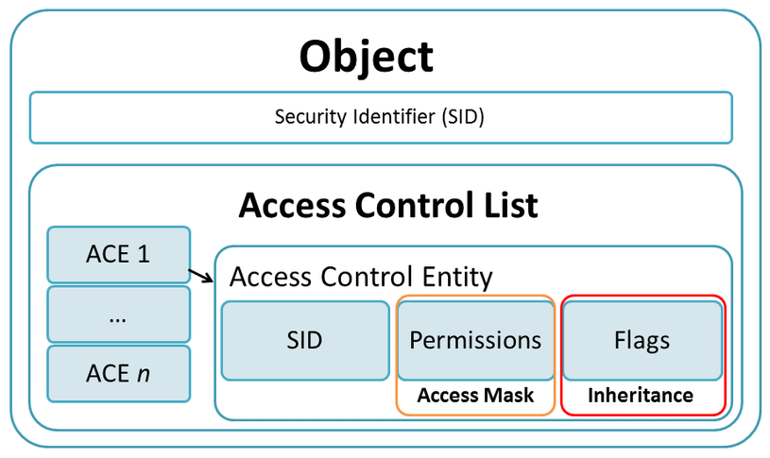

Slide 54
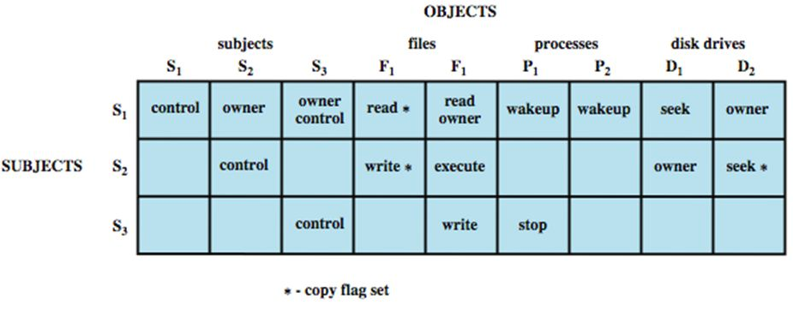
Access control matrix

Slide 55
Example
A role-based access control system
Two users: Carla (student) and Dirk (teacher)
Carla (Class: s)
Dirk (Class: T); can also login as a students thus (Class: s)
A student role has a lower security clearance
A teacher role has a higher security clearance

Slide 56
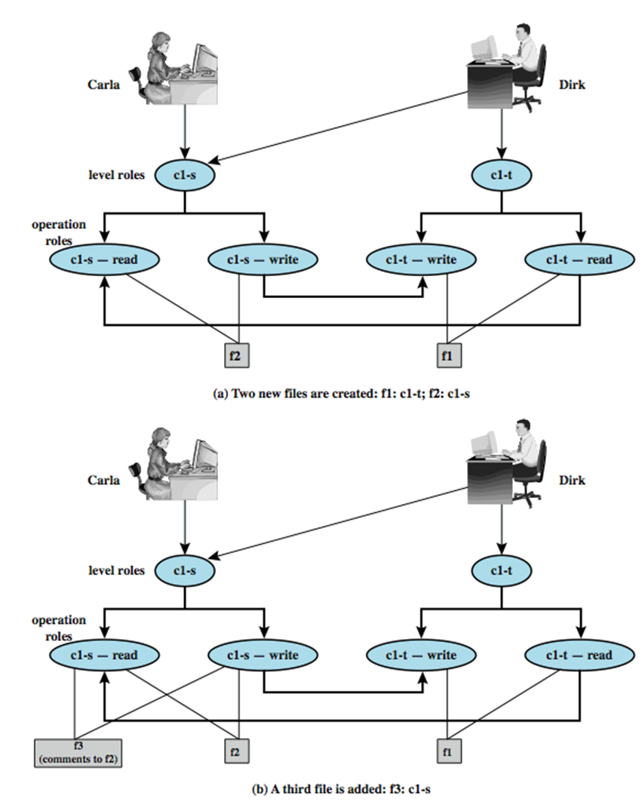
Dirk creates f1; Carla creates f2
Carla can read/write to f2
Carla can’t read f1
Dirk can read/write f1
Dirk can read f2 (if perm)
Dirk can read/write f2 only as a stu
Dirk reads f2; want create f3 (comments)
Dirk signs in as a stu (so Carla can read)
As a teacher, Dirk cannot create a
file at stu classification

Slide 57
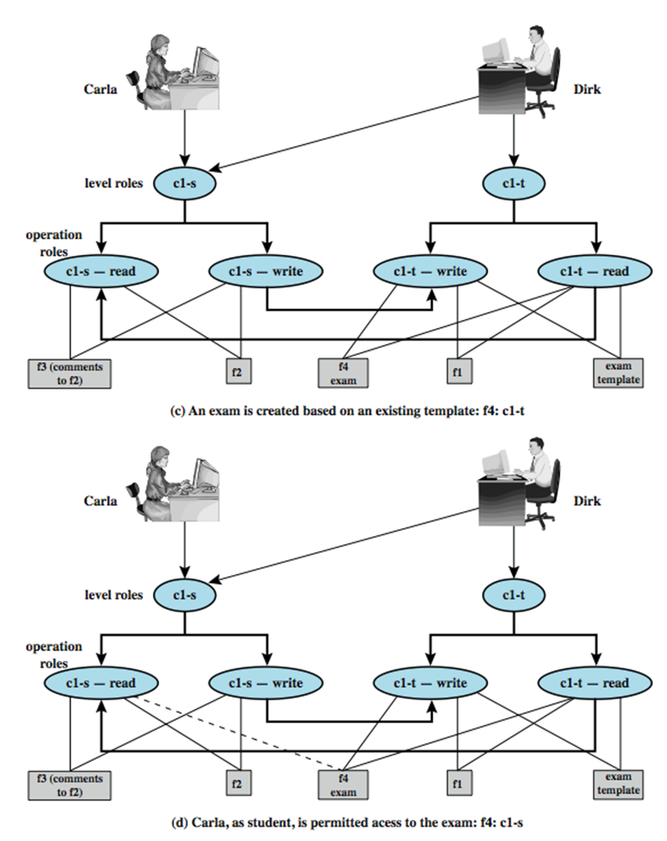
Dirk as a teacher creates exam (f4)
Must log in as a teacher to read
template
Dirk wants to give Carla access to read f4
Dirk can’t do that; an admin must do
An admin downgrades f4 class to c1-s

Slide 58
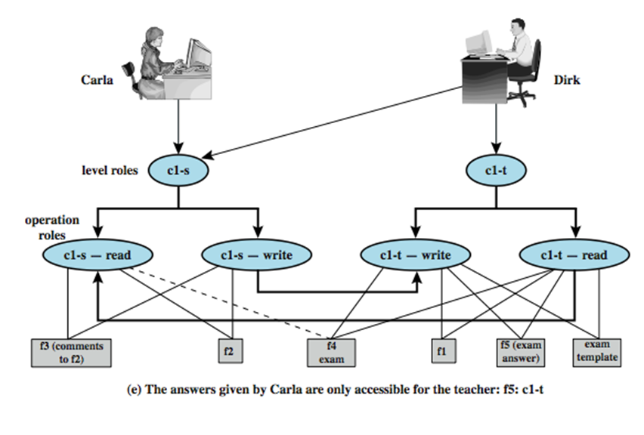
Carla writes answers to f5 (at c1-t level)
-- An example of write up
Dirk can read f5

